Slide 1
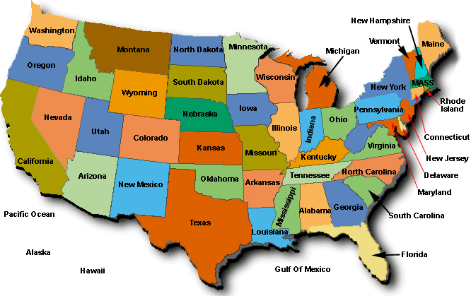
Obesity Rates in the United States
Mike Coons, Linn Slater, Michelle Williams
How does access to fast food and grocery stores affect obesity rates?

Slide 2
Motivation
“Obesity-related conditions include heart disease, stroke, type 2 diabetes and certain types of cancer that are some of the leading causes of preventable, premature death.”
“The estimated annual medical cost of obesity in the United States was $147 billion in 2008 US dollars; the medical cost for people who have obesity was $1,429 higher than those of normal weight.”
Source: https://www.cdc.gov/obesity/data/adult.html

Slide 3
Hypothesis
Increased access to fast food increases obesity rates
Increased access to healthy food decreases obesity rates
Questions Posed by Group
Is there a correlation between population and number of fast food restaurants?
Is there a correlation between population and number of grocery stores?
Is there a correlation between number of fast food restaurants and obesity rate?
Is there a correlation between number of grocery stores and obesity rate?

Slide 4

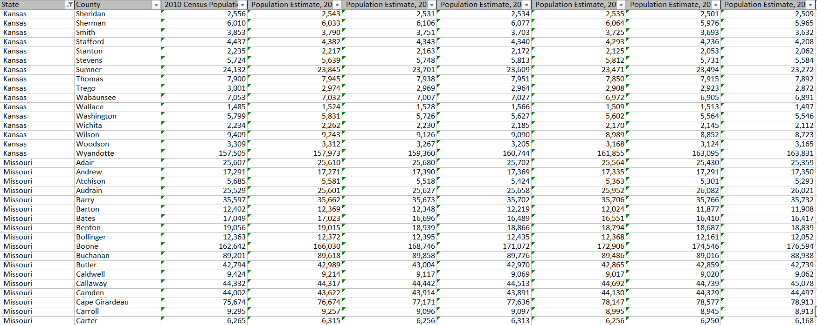
Our Data Source – Food Environment Atlas (www.data.gov)
Statistics on food environment indicators
Organized by county

Slide 5
Clean Up Time!!!
Convert 2008 & 2013 Obesity Data
Needed years 2007 & 2012
Needed years 2009 & 2014

Slide 6
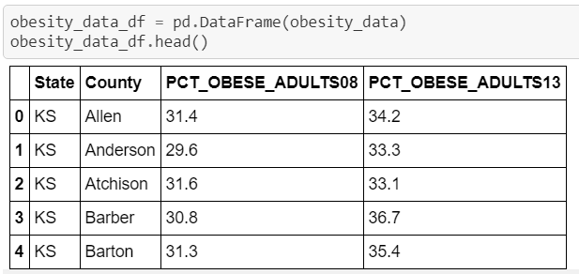
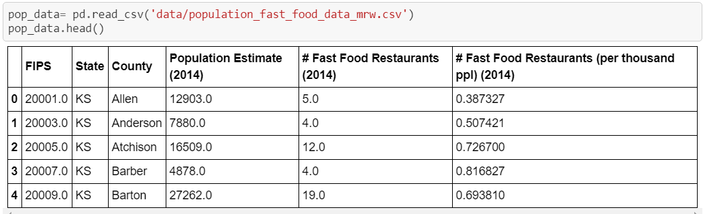
Oh, But the Dates for the Obesity Data Don’t Match the Rest of the Data!

Slide 7
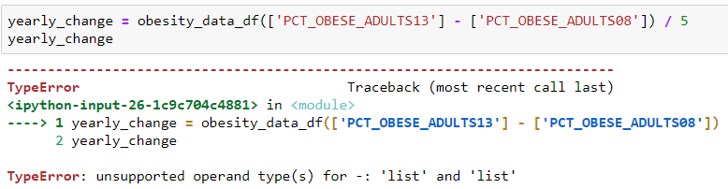
Adjusting the Data to the Correct Dates
That Won’t Work…

Slide 8
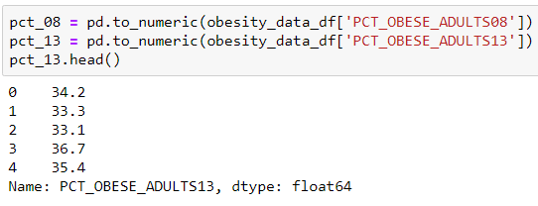
Adjusting the Data to the Correct Dates - Try Again!
That’s Better!

Slide 9
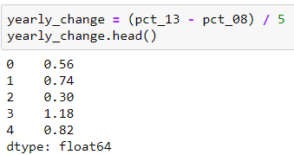
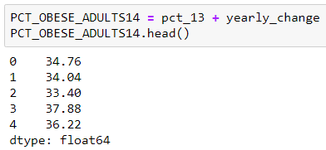
Adjusting the Data to the Correct Dates

Slide 10
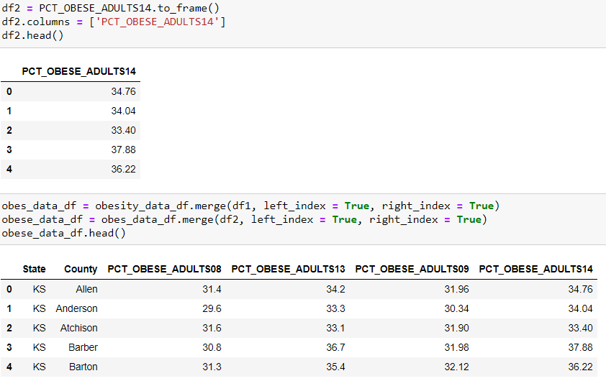
The Obesity Data Needs to Be Merged With Other Data
Export to CSV

Slide 11
More Clean Up!!!
Pulled Population, Store, and Restaurant Data
Saved as separate csv files
Deleted unneeded columns
Renamed data frame columns
Exported as new csv files
All US
Only KS & MO

Slide 12
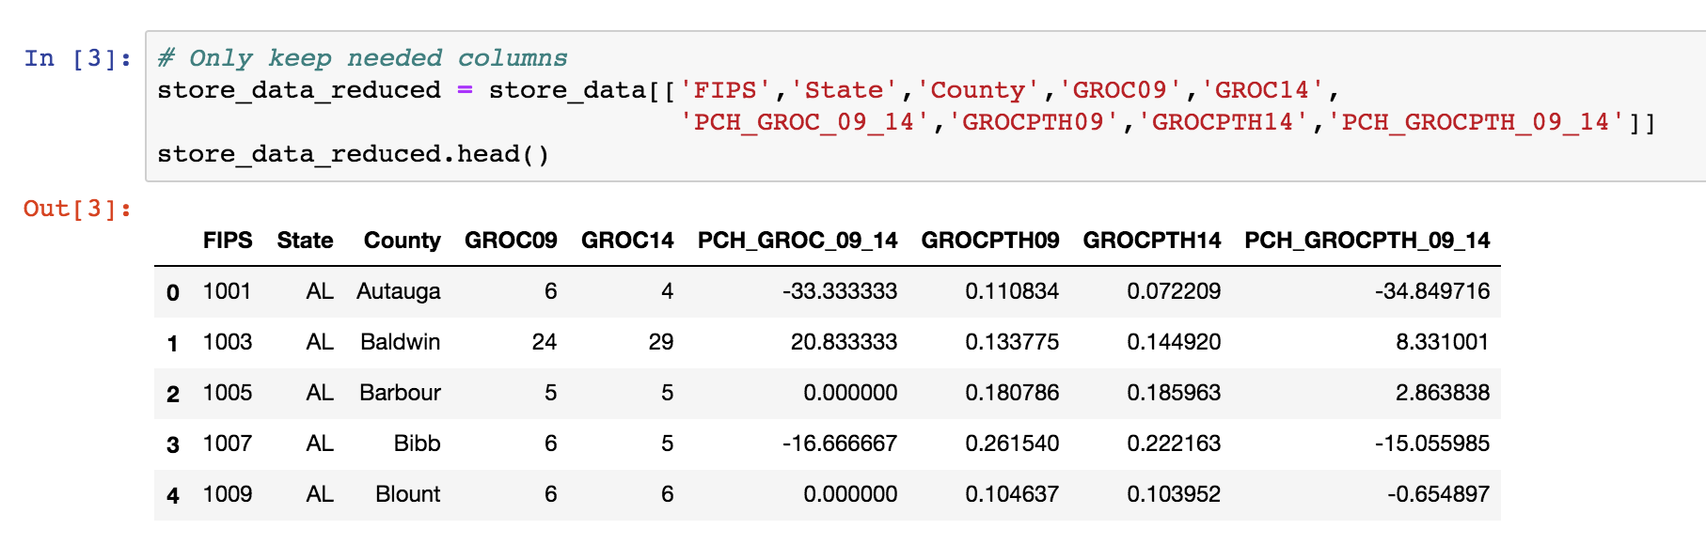
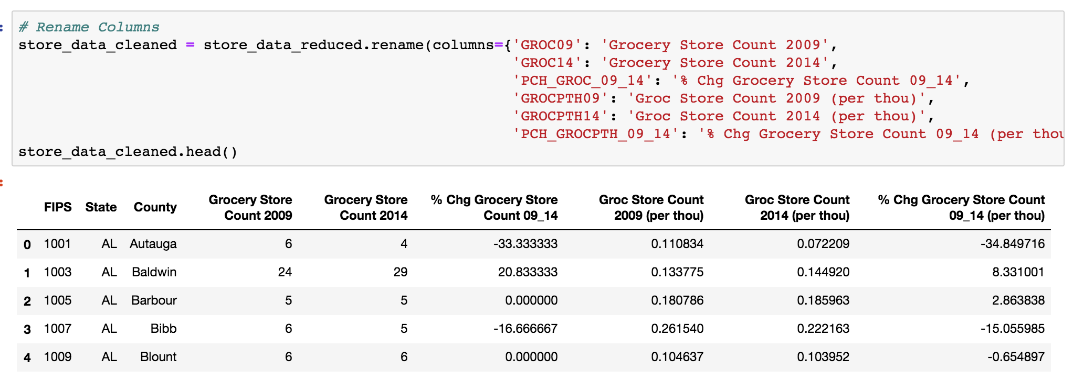
Clean Up of Population, Store, and Restaurant Data
Export US Data
to CSV

Slide 13
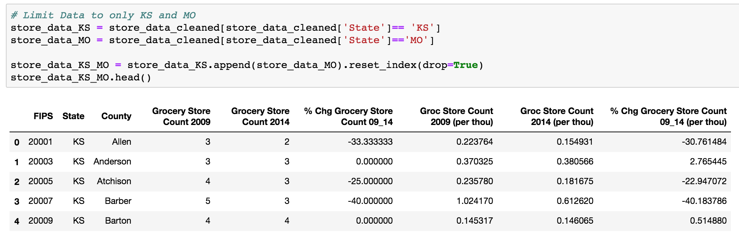
Clean Up of Population, Store, and Restaurant Data
Export KS/MO
Data to CSV
We began our analysis with only counties in KS and MO

Slide 14



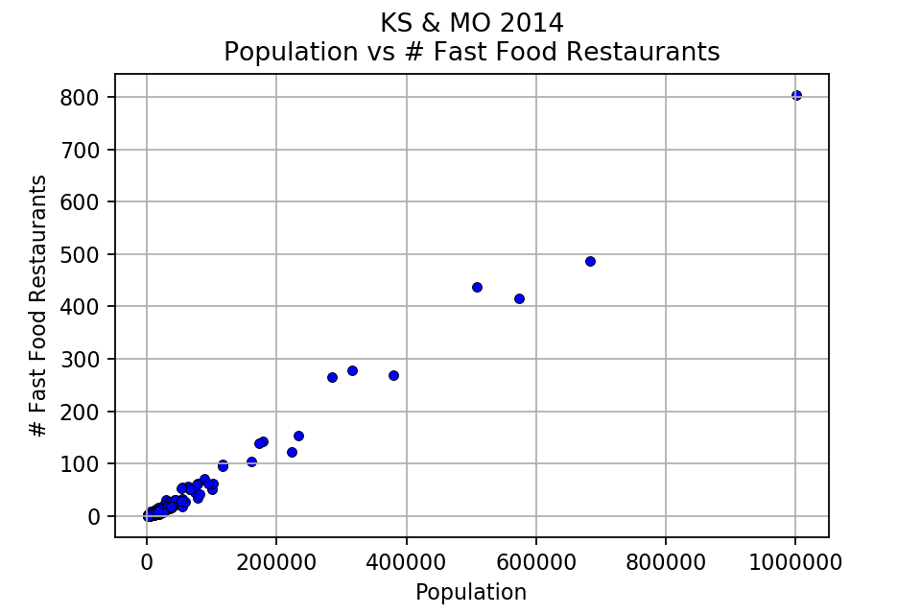
Question 1: What does the correlation between population and the number of fast food restaurants look like?
Our Analysis/Findings
Population increases → # fast food restaurants increases
Cluster within lower populations
More rural areas
Cluster

Slide 15
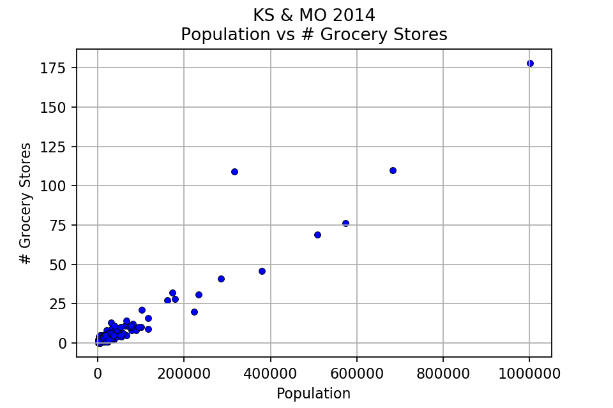
Question 2: Is there a correlation between population and number of grocery stores?
Our Analysis/Findings
Population increases → # grocery stores increase
Cluster within lower populations
More rural areas
Cluster

Slide 16
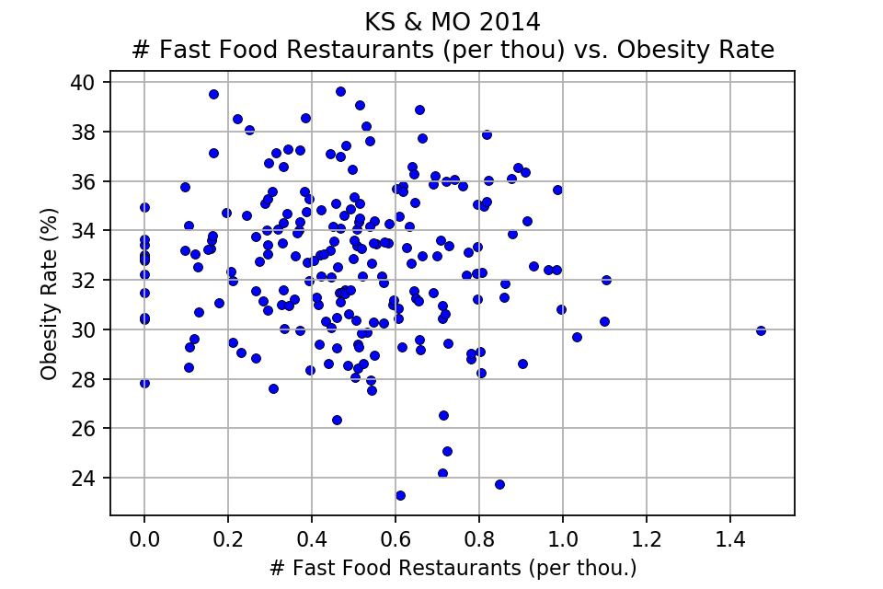
Question 3: What is the correlation between number of fast food restaurants and obesity rate?
Our Analysis/Findings
No discernable patterns
Expected a different outcome
No correlation!

Slide 17
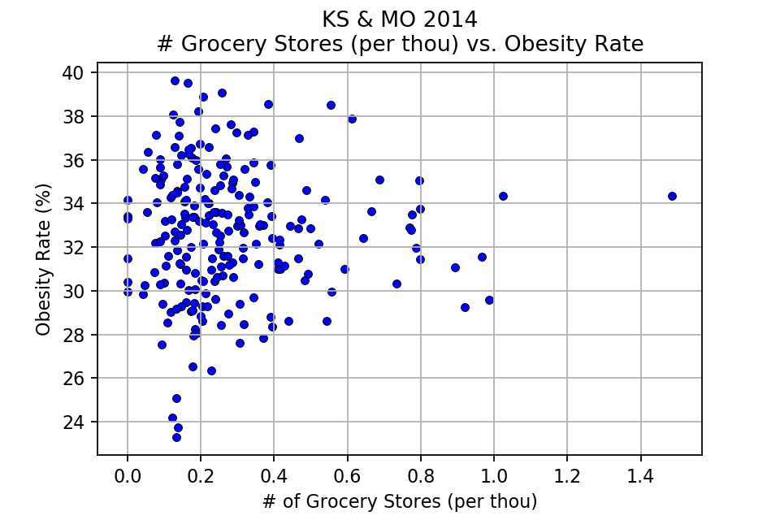
Question 4: What is the correlation between number of grocery stores and obesity rate?
Our Analysis/Findings
No discernable patterns
Expected a different outcome
Cluster of rural areas
No correlation!

Slide 18
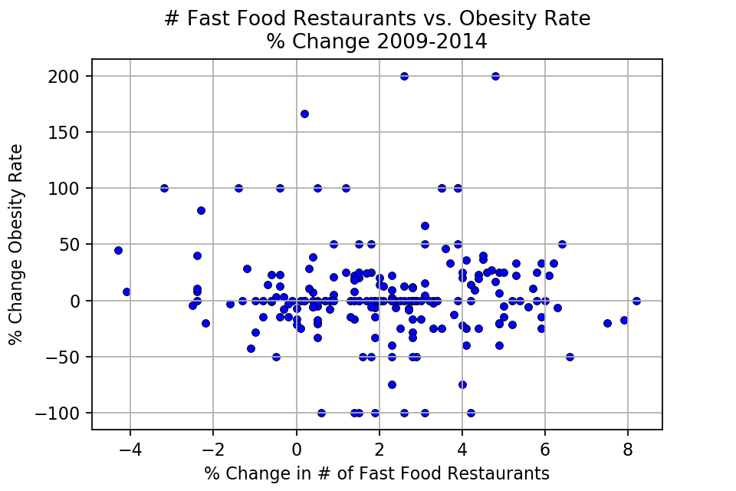
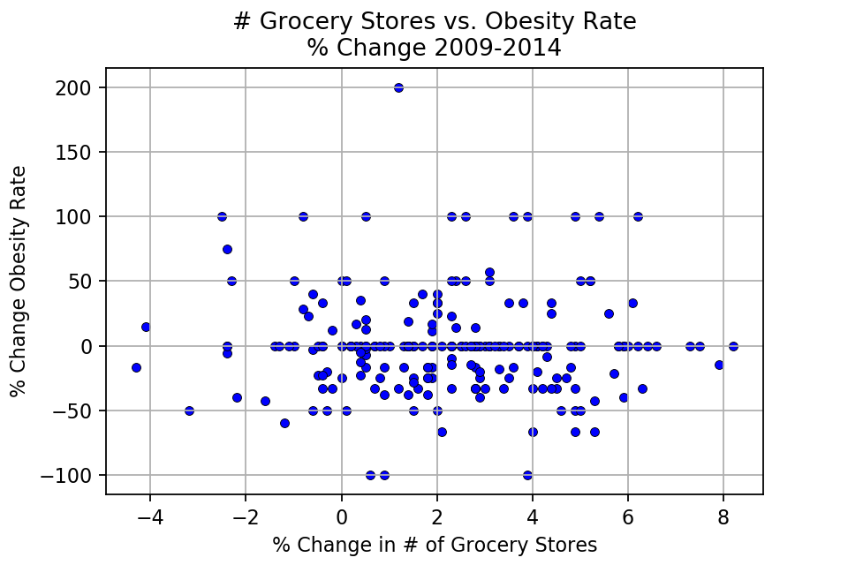
What does the data show over time?
Still no correlation!

Slide 19
Looking at only KS and MO
Limited data set
Mostly rural areas
Relatively few larger counties
No clear correlation
Now… We expand to the entire US

Slide 20

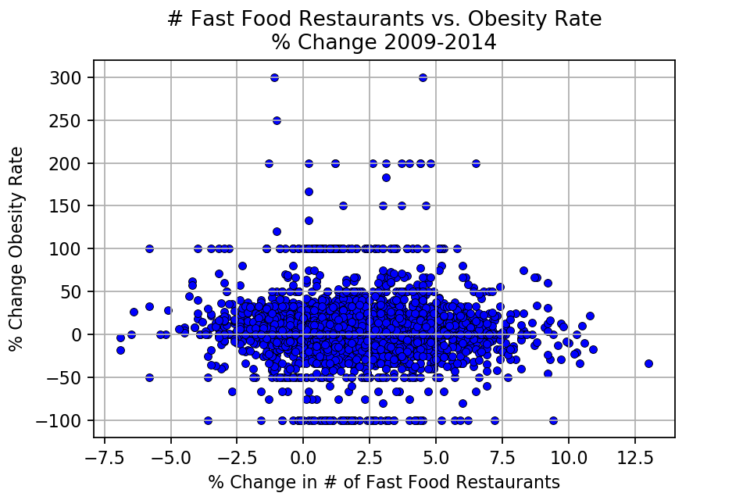
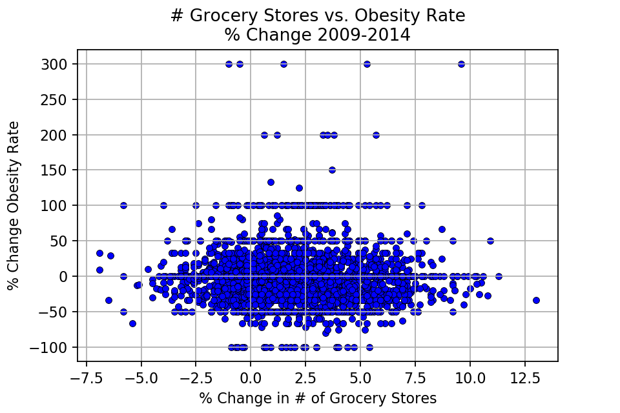
All US data shows…
Still no correlation!

Slide 21
New Question: What is the correlation between expenditure per capita and obesity rate?
Fast food
Full service restaurants
Expenditure data not accessible for grocery stores

Slide 22
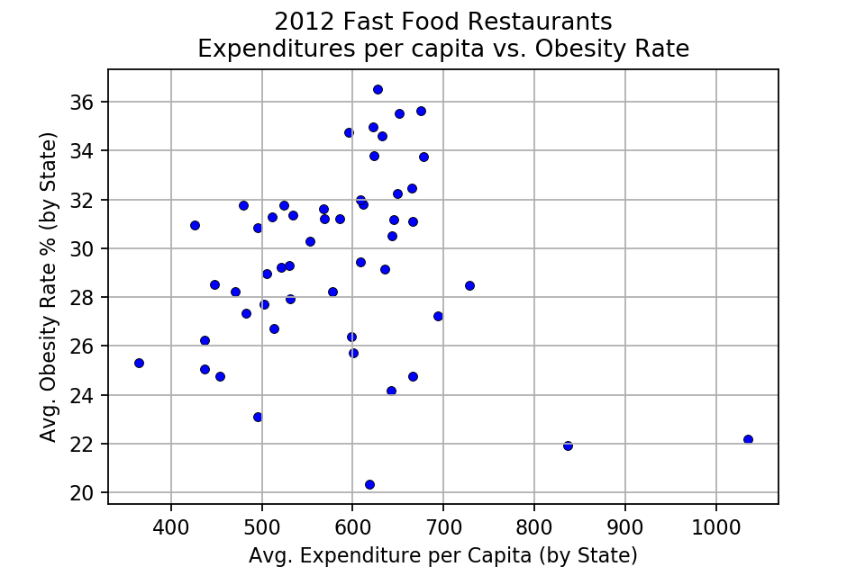
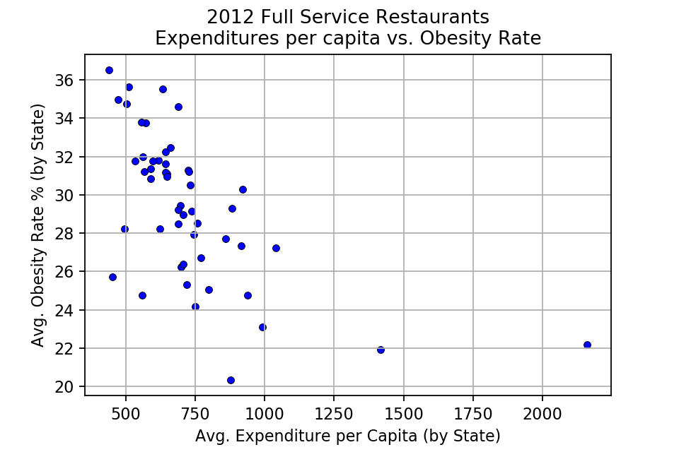
Expenditures per capita and Obesity Rate
Avg. of Avg.
Higher spending → Higher obesity rate
Outliers exist
Weak positive correlation

Slide 23
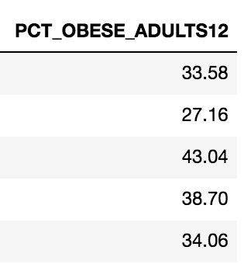
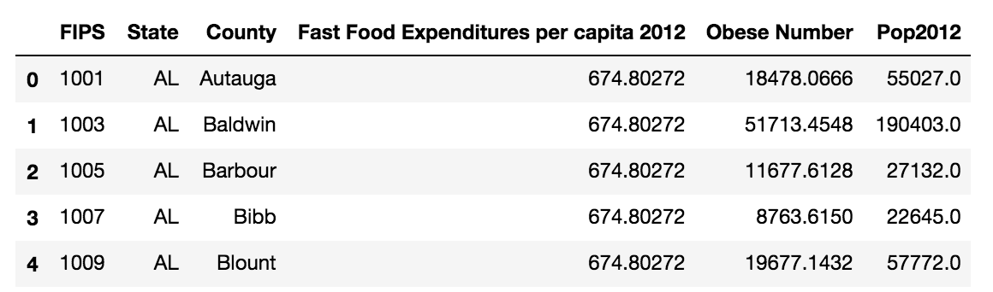
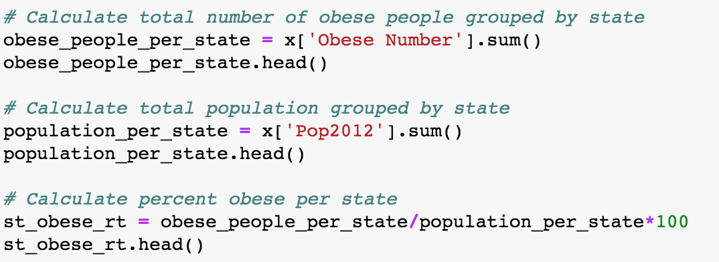
Convert Obesity Rate to Actual Avg. of State
Expenditures per capita is by state
Obese Rate is by county
Total obese by state
Total population by state
% obese = # obese/population

Slide 24
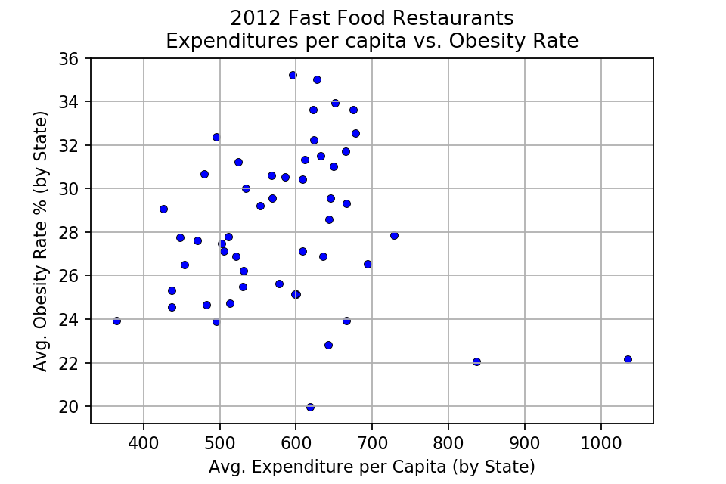
Expenditures per capita and Obesity Rate
Fast Food Actual Avg.
Our Analysis/Findings
Higher spending → Higher obesity rate
Outliers exist
Weak positive correlation

Slide 25
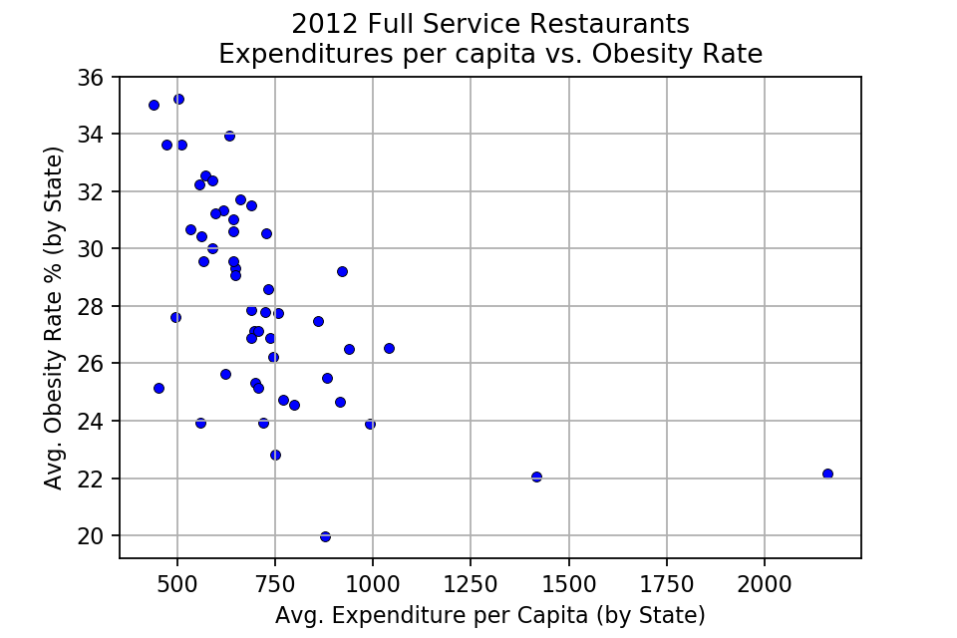
Expenditures per capita and Obesity Rate
Full Service Actual Avg.
Our Analysis/Findings
Higher spending → Lower obesity rate
Outliers exist

Slide 26
Higher spending Fast Food → Higher obesity rate
Possible Reasons for Findings
Unhealthy Ingredients
Larger Portions
Lower Cost
Convenience
Higher spending Full Service → Lower obesity rate
Access to healthier choices
Slower dining experience

Slide 27
Suggestions
Fast food restaurants need healthier options
Lower sugar and fat levels
Increase fiber

Slide 28
If More Time…
Regional differences
Cost of living
Cultural differences (eg. BBQ, southern cooking)
Climate
Analysis physical activity levels

